Slide 1



ERC-incubator:
The support for CAS applicants, investigators and institutes with ERC projects
Workshop: Excellence Support and Careers within the CAS
Petr Baldrian
21/01/2026

Slide 2

The path of the Czech Academy of Sciences towards excellence through success in ERC
The Czech Academy of Sciences strives to increase research excellence across its institutes
As the ERC grants are both a sign of an excellence in finding a competitive research topic and the opportunity to perform excellent research and recruit excellent scientists across all fields of science
The support of motivation for applications to the ERC, and the support to ERC grant holders may thus over time contribute to the CAS path to increased excellence
To increase the ERC support at the level of the Czech Academy of Sciences, the Academic Council agreed to create the ERC Incubator (ERC-in) on January 13, 2026 (new Guideline)
Importantly, ERC support also means the support of research carreers of individual researchers

Slide 3
ERC-in mission
to increase the number and quality of project proposals submitted from CAS institutes as host institutions to the ERC grant schemes and / or other prestigious grant schemes
to increase the likelihood of success in ERC calls for applicants
to support CAS institutes hosting ERC grants
to help to acquire and retain ERC grantees at the CAS as key researchers performing excellent research

Slide 4
ERC-in activities
Support for applicants through individual mentoring, mock interviews, help with career planning (no one stays out)
Support of institutes / project departments in both the preparatory and implementation phase
Growth od awareness about ERC through motivation, sharing best practice, workshops, etc.
Data and information collection for statistics and feedback

Slide 5
ERC-in structure
Research coordinator: Luděk Brož
Science domain coordinators:
SD1: Constantinos Skordis (Institute of Physics, CAS)
SD2: Vojtěch Novotný (Biology Centre, CAS)
SD3: Luděk Brož (Institute of Ethnology, CAS)
Project consultant: Štěpánka Gray Marková
Administrative contact: Jana Whalen (CAS Office)
Academy Council responsible member: Petr Baldrian
Mentors and scientific consultants providing support to applicants

Slide 6
What does ERC-in offer to ERC applicants?
Specialized career and project consultations
Individual mentoring by an experienced researcher during proposal preparation and, if successful in reaching the second evaluation step, preparation for the ERC interview
Mock interview designed specifically for each applicant/proposal reaching the second step of the evaluation
Funding to remunerate mentors and scientific consultant(s) who were instrumental in critically commenting on the project proposal
Help with preparing the “technical” parts of proposal such as the project budget

Slide 7
What does ERC-in offer to CAS institutes?
Financial support for ERC project preparation of institute’s researchers accepted to ERC-in to cover the costs of project preparation
Facilitation of know-how sharing with / among institutions with ERC experience
Help with building project department infrastructure
Assistance in aligning the ERC proposal with workplace conditions (negotiation of space / equipment / overheads)
Support during the project lifetime and the integration of ERC teams into the institutes research environment when the project is finished
Help with stimulating researchers’ interest in the ERC funding

Slide 8
Outreach, motivation and feedback
Raising awareness of ERC schemes within the CAS, both among potential applicants and the institutes through information materials, workshops, etc.
Communication of CAS success and building the awareness of CAS as an ERC-friendly institution
Collection of data on the success of CAS institutes in ERC competitions for the analysis of performance in comparison to competing institutions
Establishment of a knowledge base on ERC funding – in particular, but not limited to, the format of applications, eligibility, deadlines, evaluation criteria, success rates, prospects, trends, etc.

Slide 9
Other modes of ERC support within CAS
Academy of the Future has a special scheme (Programme C) for financial support of visits
  at ERC host labs (for applicants) up to 30 days
  at ERC host institutions (for management / administrative staff) up to 7 days
  institutes have themselves the opportunity to decide who to send where
Incoming grants of the Academy of the Future mav be a possible first step in recruiting future ERC applicants (First call in May this year)
CAS supports the Expert Group at the Technology Centre Prague that prepares applicants across the Czech Republic. CAS researchers are free to use their service to boost their ERC chances

Slide 10
ERC incubator:
How to apply for support?

Slide 11

Who can apply?
Researchers who plan to submit an individual ERC proposal hosted by one of the CAS institutes are eligible for the ERC-in support through the respective institute
The researcher must be an employee of one of the CAS institutes (at least with temporary contract)
Researchers considering StG, CoG or AdG
Technically, the institute applies

Slide 12
Application for enrolment in the ERC-in
Application form
  Basic information about the applicant and research project (description of the ERC project proposal and of its groundbreaking nature, information on current projects the applicant is carrying out during the preparation of the ERC project as the PI)
CV template
  The template is based on the original ERC CV template
Declaration form
  The host institute declares endorsement of the candidate and their proposal, commitment to mentor agreement and sharing final proposal and results with ERC-in
Send your application through the host institute to the CAS data box (ID: fr6adt5) to apply for enrolment into ERC-in

Slide 13
Application form / Curriculum Vitae
Description of the ERC project that the candidate plans to submit
Groundbreaking nature of the planned research (please describe which groundbreaking results will be achieved if the proposal is successful)
Describe your past contribution to your field of research and your most significant research achievements
Five best scientific results (with the declaration of your contribution)
Up to three best grants that you received as a principal investigator
Have you applied for ERC funding before? If yes, when and what was the result?
The ERC-in Council uses this information to select candidates for ERC-in support

Slide 14
ERC-in eligible costs
Program is run in accordance with Guideline of the Academy Council of the Czech Academy of Sciences No. 1 dated 13 January 2026 on ERC Incubator
Eligible costs
  Preparation of the 1st round proposal – up to 60 000 CZK
  Preparation for the 2nd round interview – up to 60 000 CZK
  Mentor‘s personnel costs, costs of soft skills training, fees for scientific consultants, material costs directly related to the preparation of the ERC project proposal
Non-eligible costs
  investment costs
  overhead costs
  costs of usual research or administrative activities that are not oriented towards ERC-in activities

Slide 15
Application for enrolment in the ERC-in - Deadlines
 | ERC Call | ERC Call deadline | Deadline for application for ERC-in
Proposal preparation | ERC-AdG-2026 | August 2026 | ASAP
 | ERC-StG-2027 | October 2026 | 1 March 2026
 | ERC-CoG-2027 | February 2027 | 1 May 2026
Preparation for the Interview (2nd round) | ERC-AdG-2025 | August 2025 | ASAP
 | ERC-StG-2026 | October 2025 | TBC
 | ERC-CoG-2026 | January 2026 | TBC

Slide 16
Grant processing by the institute – request for grant
Institute is requested to submit grant application via KIS ECO once your candidates enrolment in the ERC-in is approved
Call No. (výzva ev. č.) 05/2026 Podpora činnosti pracovišť (PČP)
Dates for submission in 2026:
  10th February
  14th April
  10th June
  12th October

Slide 17
Grant processing by the institute – request for grant
Institutes submit a report for the previous period by February 8
The report contains:
  Report of realized activities
  Brief plan of activities for the next calendar year
  Planned budget for the next calendar year

Slide 18
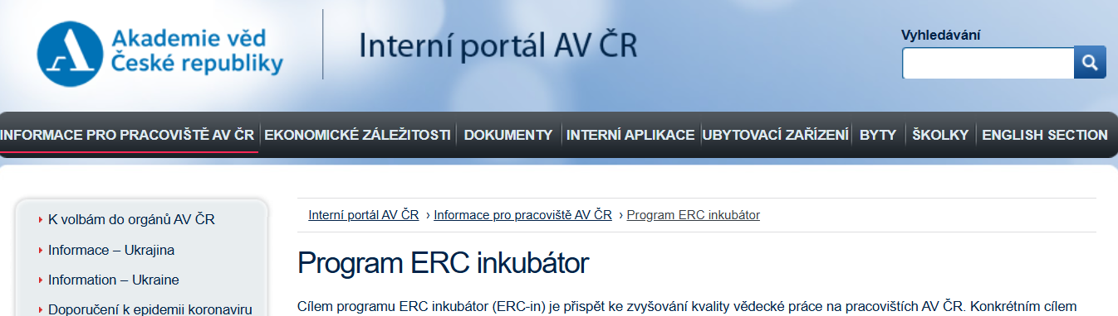
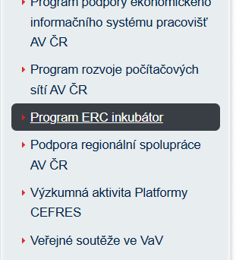
Where to find information? – Application form + Guideline
CAS Internal portal: https://interni.avcr.cz/Informace_pro_pracoviste/Program-ERC-inkubator/

Slide 19

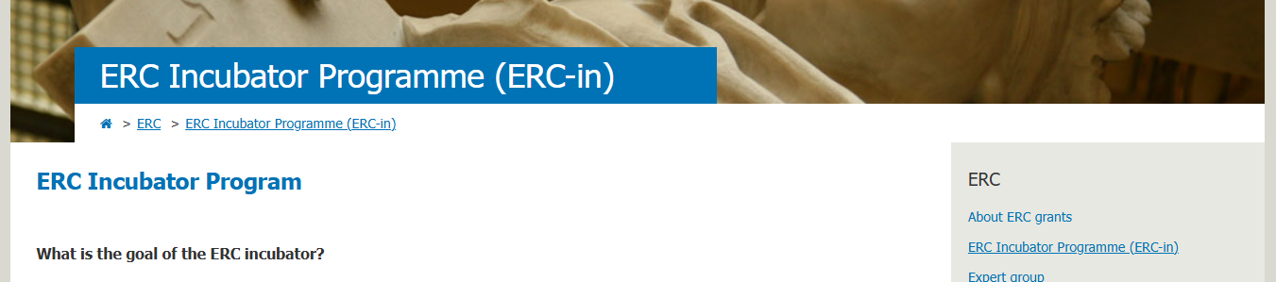
Where to find information? – Application form + Guideline
Or on the CAS website: Academic Public (Věda a výzkum), International Cooperation, European Research Area – ERC
https://era.avcr.cz/en/ERC-interface/ERC-Incubator-Programme-ERC-in/

Slide 20
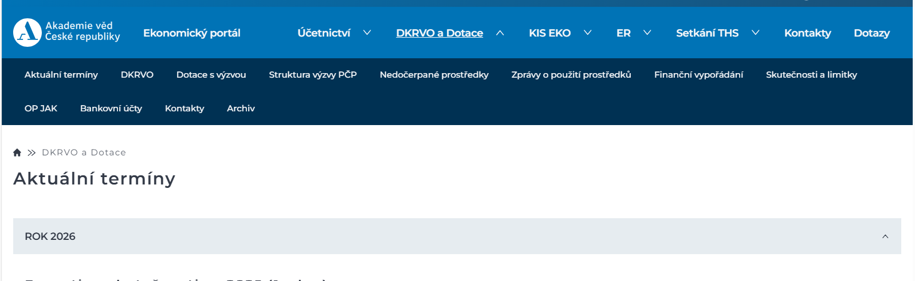
Where to find information? – Grant application
CAS website for the call (výzva) 05/2026 Podpora činnosti Pracovišť Aktuální výzvy AV ČR - Akademie věd České republiky
CAS Economic Portal for dates and more details https://interni.avcr.cz/Informace_pro_pracoviste/Program-ERC-inkubator/

Slide 21
Information & Contacts
ERC-in webpage:
https://era.avcr.cz/cs/Rozhrani-ERC/Program-ERC-inkubator-ERC-in/
The Guideline on the ERC incubator:
  https://interni.avcr.cz/Dokumenty/Interni_normy/
General e-mail address:
  erc-in@kav.cas.cz
Contact:
Jana Whalen, T: 221 403 354, whalen@kav.cas.cz

Slide 22

Thank you for your attention!
Petr Baldrian | baldrian@kav.cas.cz | +420 723 770 570

